Slide 1
Internet of Things Track
Amy Nicholson – Technical Evangelist
@AmyKateNicho
Allan Mitchell – Real-Time Data Consultant
@allanSQLIS

Slide 2
The Internet of Things
Things
Connectivity
Connected world solutions combine sensors and technologies to enable objects and infrastructure to interact with monitoring, analytics and control systems over Internet-style networks.
Data
Analytics
Source: Forrester

Slide 3
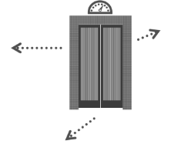
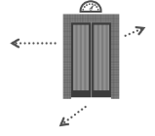
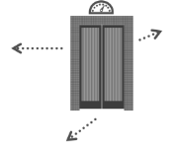
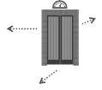
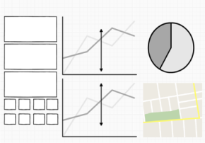
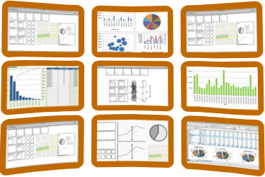
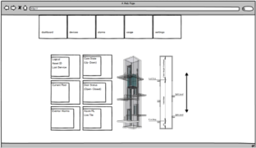
An example of the Internet of Things
`
`
Field worker
Control center
Business planner

Slide 4
Why Now ?
IoT is at an inflection point
Components and devices are less expensive
Connectivity is pervasive
Development is easy
New scenarios fuel demand
Economic benefits are enormous
Forward-leaning businesses and individuals are connecting their things today to create new kinds of value
Notes:
Why Now?
For years forward thinking companies/industries like Rolls-Royce and Formula 1 have been connecting sensors and devices across their business to drive business advantage.
Pulling data from things such as tyre temperature in F1 to turbine speed in aeroplane engines, we know companies have driven insight and new business models.
With the cost of compute storage and transfer being at an all time low now is the time to take advantage for IoT.
Devices & sensors
It has never been so inexpensive to buy things, for example sensors can be bought for less than 1 Euro
Connectivity
We’ve never been more connected than we are today. The current generation have always been connected, so now there is little division between work and home.
Development
Cloud services now make it easy to both develop and deploy scalable rapid solutions across your business
New Scenarios
These last 3 points are all enabling and driving new business scenarios.

Slide 5
Why Businesses Need IoT Now
Gain insight and agility
Build competitive edge
Open new business opportunities
Redefine customer service

Slide 6

Microsoft’s view
The Internet of Things starts with Your Things.
Build on the infrastructure you already have.
Add more devices to the ones you already own.
Get more from the data that already exists.
Stop just running your business.
Start making it thrive. Start realizing the potential of the Internet of Your Things.

Slide 7

Event producers
Collection
Event Queuing System
Transformation
Long-term storage
Presentation and action
Apache Storm on HDInsight
Kafka
RabbitMQ
ActiveMQ
HBase
Web/thick client dashboards
Applications
HDFS
Azure DBs
Event Hubs
Azure Stream Analytics
Search and query
Cloud gateways (web APIs)
Stream processing
Devices
Azure storage
Live Dashboards
Data analytics (Excel)
Sensors
Field gateways
Storage adapters
Web and Social
Devices to take action
Notes:
Hadoop suits multiple data platform needs in a variety of workloads. In a canonical IoT scenario you will find Hadoop supporting streaming, realtime, and batch oriented workloads. Microsoft Azure will support all these workloads from a 1st party (Microsoft developed) service, as well as 3rd party (Partner developed) solutions.

Slide 8
Build and Deliver Differentiated Services
Connected devices and data
Intelligent systems
Personalised experiences
1
2
3

Slide 9
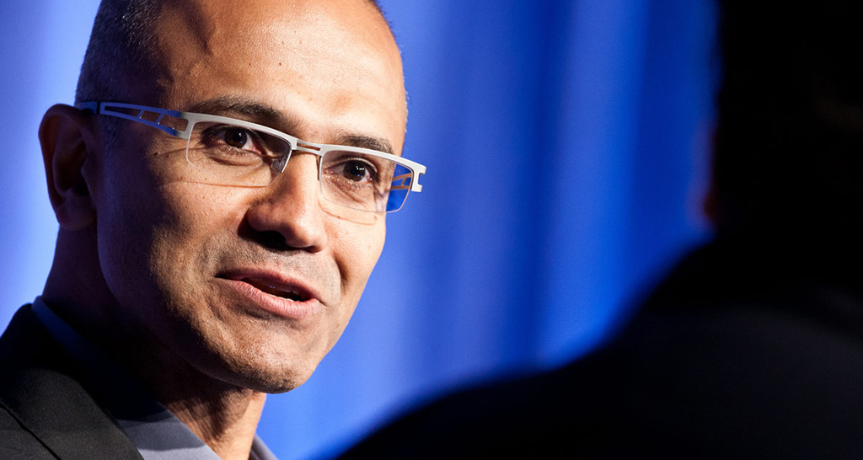
I believe over the next decade computing will become even more ubiquitous and intelligence will become ambient...This will be made possible by an ever-growing network of connected devices, incredible computing capacity from the cloud, insights from big data, and intelligence from machine learning.

Slide 10
Blinky and the Cloud Connecting your devices to the cloud
@AmyKateNicho
@allanSQLIS

Slide 11

Azure Service Bus
Infrastructure service
Provides services for communications between applications
Core services: Relays, Queues, Topics, Events hubs and Notifications

Slide 12
Azure Event Hubs
High –volume message ingestion service
Millions of events from millions of data sources per second
HTTPS/AMQP

Slide 13
Azure Blob Storage
Large amounts of unstructured data in many varieties
Use containers to logically group your files
Durable and highly avaliable and scalable

Slide 14



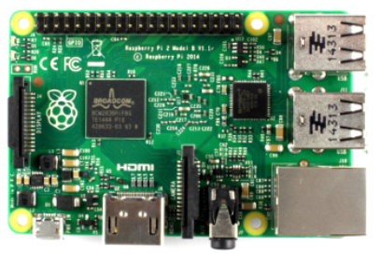
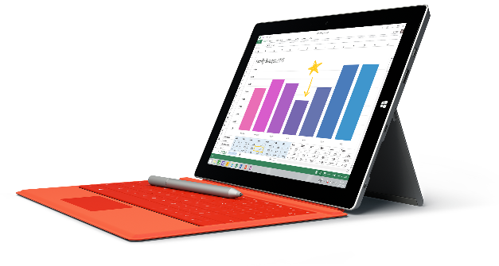
Blinky and the Cloud: Architecture

Slide 15
DEMO – Blinky and the Cloud
@AmyKateNicho

Slide 16
Azure Stream Analytics Processing data in the cloud in real time using an Azure Service
@AmyKateNicho
@allanSQLIS

Slide 17
Azure Stream Analytics
Real-time stream processing in the cloud
Out-of-the-box integration with Event Hubs
Ability to compare real-time streams with historical values and models

Slide 18

Azure Stream Analytics: Components
INPUT
OUTPUT
STREAM ANALYTICS QUERIES
Azure SQL DB
Azure Event Hubs
Azure Blob Storage
Azure Blob Storage
EVENTS
Have a defined schema and are temporal (sequenced in time)
Azure Event Hubs
Azure Table Storage
Reference Data
Power BI
Query runs continuously against incoming stream of events
Notes:
Now let us dig deeper into what a typical ASA application looks like. An ASA application has three major components:
Input – Inputs are the sources of events. Note that the ‘original’ source of streaming events are devices, machines, applications, sensors, applications etc. However, ASA is not intended to connect to them directly. Rather ASA lets Azure Event Hubs be the primary interface to the wide variety of event sources. ASA is optimized to get streaming data from Azure Event Hubs and Azure Blob Storage. Azure Blob Storage is the likely place where log data is stored. The list of input sources that ASA directly integrates with may increase in the future, but Azure Event Hubs and Azure Blob Storage will be the primary sources.
Query – Queries are the main component of an ASA application. Queries implement the “analytics logic”. Queries are a set of transformations that are applied to the input stream to produce another set of output events. Queries are the only thing that an ASA application developers actually ‘develops’. Everything else is done through guided wizards in the Azure Portal. Note that ASA has a SQL-like query language but unlike traditional databases, ASA queries run continuously against the stream of incoming events. The queries stop being applied only when the job itself stops.
Output – As queries execute they continuously produce results. The results can be stored in Blob Storage, Event Hubs or Azure SQL database. Note that if the output is stored in Event Hub or Blob Storage, it can become the input to another ASA job. So it is possible to ‘chain’ together multiple jobs to implement a series of transformations.

Slide 19
Azure Stream Analytics: Windowing
Tumbling Window
Time

Slide 20
Azure Stream Analytics: Windowing
Hopping Window
Time

Slide 21
Query Language - Overview
DML Statements
SELECT
FROM
WHERE
GROUP BY
HAVING
CASE
JOIN
UNION
Date and Time Functions
DATENAME
DATEPART
DAY
MONTH
YEAR
DATETIMEFROMPARTS
DATEDIFF
DATADD
Aggregate Functions
SUM
COUNT
AVG
MIN
MAX
Scaling Functions
WITH
PARTITION BY
Windowing Extensions
Tumbling Window
Hopping Window
Sliding Window
Duration
String Functions
LEN
CONCAT
CHARINDEX
SUBSTRING
PATINDEX
Notes:
Speaker Notes:
Mention that this slide provides an at-a-glance overview of the query capabilities of the SA query language. As noted earlier while some/most of the operators are vanilla T-SQL capabilities there are some features specific to analysis of streaming data such as the Windowing Extensions, scaling functions, DATEDIFF etc.
The subsequent slides will go into these functions in greater detail.

Slide 22
Azure SQL Database
A relational database-as-a-service
Elastic database model
Supports popular platforms and technologies: .NET, Java, PHP, Ruby on Rails and Node.js

Slide 23
Power BI
Transform your data into rich visuals
Connect data from a huge amount of data sources
Create personalised dashboards and make confident decisions

Slide 24



Azure Stream Analytics: Architecture
Applications
Sensors
Devices

Slide 25
DEMO – Azure Stream Analytics
@AmyKateNicho

Slide 26
Storm on Azure
@AmyKateNicho
@allanSQLIS

Slide 27



Storm on Azure: Architecture
Applications
Sensors
Devices

Slide 28
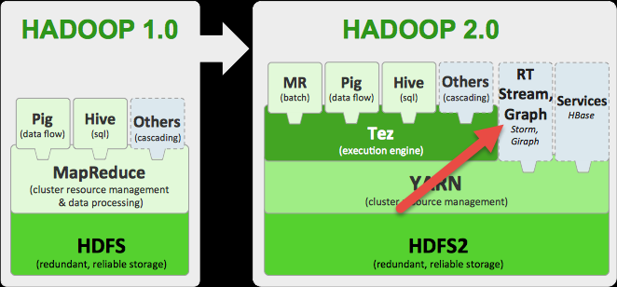
Hadoop Ecosystem
Notes:
Show again where is Storm in the Hadoop ecosystem and the whole point about us talking about Hadoop

Slide 29
Storm Concepts
Tuple
(“Allan Mitchell”, “Storm Concepts”, “2014-11-22”)
Notes:
Elements/data

Slide 30
Storm Concepts
Stream
Tuple
Tuple
Tuple
Tuple
Tuple
Tuple
Notes:
Ordered sequence of tuples (unbounded). Big point here is that you may not be on the start of the stream and it has no concept of an end either. Standing data is just that, standing. It sits there and you consume it.

Slide 31
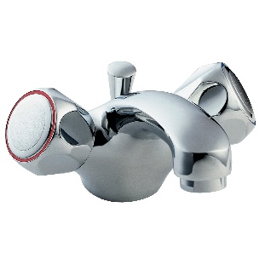
Storm Concepts
Spout
Tuple
Tuple
Tuple
Tuple
Tuple
Notes:
Spouts are the sources of the data so logs, database, API. They pour data into the topology.

Slide 32
Spouts
Producers of Data
Logs
API
Queues
Event Data
Notes:
They work with static data as well as streaming data

Slide 33
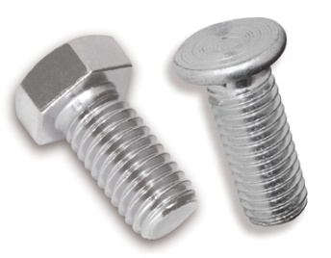
Storm Concepts
Bolts
Tuple
Tuple
Tuple
Tuple
Tuple
Tuple
Tuple
Tuple
Tuple
Notes:
Analytical functions, Filters, Aggregations, joins

Slide 34
Bolts
Operate on the streams
Aggregation
Filter
Project
Analytics
Windowing
…

Slide 35
DEMO – Storm on Azure
@AmyKateNicho

Slide 36
What's Next? Grab lunch, then it’s your turn!
@AmyKateNicho
@allanSQLIS

Slide 37
